Slide 1
Catalogue of undergraduate courses delivered in English by areas
Agricultural, Forest & Environmental Technologies
Information & Communication Technologies
Biomics
Bioreactors
Immunology
Multiple use of natural products
Plant molecular biology
Uses of medicinal and aromatic plants
Virology
Zoology
Analog electronics
An introduction to electronics
Bioinspired algorithms for optimization
Calculus
Concurrent and Advanced Programming
Digital electronics
Digital signal processing (Telecommunications Engineering)
Digital signal processing (Computer Systems Engineering)
Distributed systems
Dynamical systems
Electromagnetics
Embedded system design with Raspberry Pi
Embedded systems modelling
Human-computer interaction
Information coding
Information security
Introduction to biocomputing
Introduction to artificial intelligence in the cloud
Introduction to machine learning
Logic
Mobile app development
Mobile communications
Probabilities and statistics I
Programming I
Programming II
Programming language translator
Programming project
Programming scalable systems
Quantum information
Random signals
Signals and systems
Software architecture and design
Spatial data infrastructure
System administration
Video game development and artificial intelligence
Web development
Industrial Technologies
Advanced mathematics in engineering
Computer-aided manufacturing workshop
Composite materials
Design and selection of materials in 3D printing
Design for manufacturing and assembly
Drawing and sketching for designers and engineers
Finite element-based simulation model
Introduction to chaos applied to systems, processes and product design Introduction to mechatronic systems design
Introduction to hybrid energy systems
Materials recycling
Mechanical behaviour of materials III
Mechanics of materials IV
Nanotechnology
Numerical Simulation
Photovoltaic-powered products
Practical Internet of Things with Raspberry Pi
Properties of materials II
Quality and management
Soft materials
Surface Engineering
Water and sustainability
Building Technology & Civil Engineering
Management and Spanish Culture
History of urban law and planning
Art, technology and society
Intellectual capital and knowledge management
Spanish language course
Women in science and technology

Slide 2
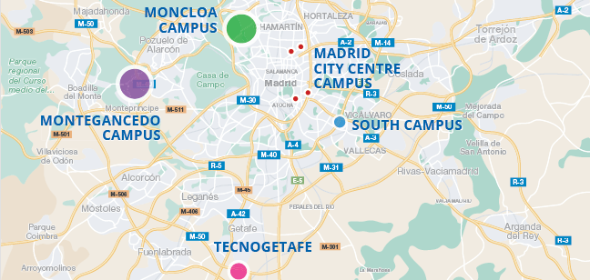
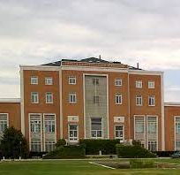
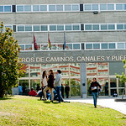
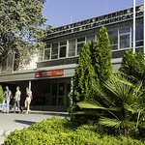
Moncloa Campus
Catalogue of undergraduate courses delivered in English by Schools
UPM Campuses: Locations
 | SCHOOL OF AGRICULTURAL, FOOD AND BIOSYSTEMS ENGINEERING (ETS DE INGENIEROS AGRÓNOMOS, ALIMENTACIÓN Y BIOSISTEMAS) Av. Puerta de Hierro, 2 – 4, 28040 Madrid Catalogue of courses delivered in English
 | Fall/Autumn Semester Bioreactors Immunology | Spring Semester Biomics Plant molecular biology Virology
 | SCHOOL OF BUILDING TECHNOLOGY (ETS DE EDIFICACIÓN ) Av. Juan de Herrera, 6, 28040 Madrid, Spain Catalogue of courses delivered in English History of urban law and planning
 | SCHOOL OF CIVIL ENGINEERING – MONCLOA CAMPUS (ETS DE INGENIEROS DE CAMINOS, CANALES Y PUERTOS) C/ Prof. Aranguren, s/n, 28040 Madrid – Spain Catalogue of courses delivered in English
 | Fall/Autumn Semester Composite materials Mechanical behaviour of materials III Numerical Simulation Properties of materials II Soft materials | Spring Semester Materials recycling Mechanics of materials IV Nanotechnology Quality and management Surface engineering
 | SCHOOL OF FOREST ENGINEERING AND NATURAL RESOURCES (ETS DE INGENIERÍA DE MONTES, FORESTAL Y DEL MEDIO NATURAL) C/ Antonio Novais, 10, 28040 Madrid – Spain Catalogue of courses delivered in English
 | Fall/Autumn Semester | Spring Semester Multiple uses of natural products Uses of medicinal and aromatic plants Zoology
 | SCHOOL OF TELECOMMUNICATIONS ENGINEERING (ETSI TELECOMUNICACIÓN) Avda. Complutense, 30, 28040 Madrid – Spain Catalogue of courses delivered in English
 | Fall/Autumn Semester Digital electronics Digital signal processing Electromagnetics Random signals Signals and systems | Spring Semester Analog electronics An introduction to electronics Spatial data infrastructure

Slide 3
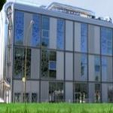
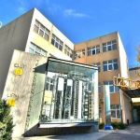
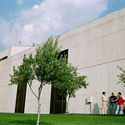
Undergraduate academic offering in English by Schools
City Centre Campus
 | SCHOOL OF INDUSTRIAL ENGINEERING AND DESIGN (ETS DE INGENIERÍA Y DISEÑO INDUSTRIAL) C/ Ronda de Valencia, 3, 28012 Madrid, Spain Catalogue of courses delivered in English
 | Fall/Autumn Semester Art, technology and society Computer-aided manufacturing workshop Design and selection of materials in 3D printing Intellectual capital and knowledge management Introduction to mechatronic systems design Practical Internet of Things with Raspberry Pi Spanish language course | Spring Semester Advanced mathematics in engineering Design for manufacturing and assembly Drawing and sketching for designers and engineers Finite element-based simulation model Introduction to chaos applied to systems, processes and product design Introduction to hybrid energy systems Photovoltaic-powered products Spanish language course Water and sustainability
South
Campus
Montegancedo
Campus
SCHOOL OF COMPUTER SYSTEMS ENGINEERING (ETS DE INGENIERÍA DE SISTEMAS INFORMÁTICOS) C/ Alan Turing s/n 28031 Madrid, Spain Catalogue of courses delivered in English Fall/Autumn Semester Artificial Intelligence Distributed systems Information Coding Quantum information System administration Video game development and artificial intelligence Web development Spring Semester Concurrent and advanced programming Bioinspired algorithms for optimization Digital signal processing Embedded systems modelling Information security Mobile app development Programming language translator Software architecture and design | SCHOOL OF TELECOMMUNICATIONS AND SYSTEMS ENGINEERING (ETS DE INGENIERIA Y SISTEMAS DE TELECOMUNICACIÓN) C/ Nikola Tesla s/n 28031 Madrid, Spain Catalogue of courses delivered in English Fall/Autumn Semester Introduction to machine learning Mobile communications Spring Semester Dynamical systems Embedded system design with Raspberry Pi Introduction to artificial intelligence in the cloud Women in science and technology |  | SCHOOL OF COMPUTER ENGINEERING (ETS DE INGENIEROS INFORMÁTICOS) Campus de Montegancedo s/n 28660 Boadilla del Monte, Madrid, Spain Catalogue of courses delivered in English Fall/Autumn Semester Introduction to biocomputing Logic Programming I Spanish for international students Spring Semester Calculus Human-computer interaction Probabilities and statistics I Programming II Programming project Programming scalable systems Spanish for international students Professional and Academic Spanish

